Slide 1
Prototype Design Pattern

Slide 2
In this session we will learn
What is a prototype design pattern
Shallow and Deep Copy
MemberwiseClone Method and ICloneable Interface
Prototype Design Pattern Example

Slide 3
Prototype Design Pattern Definition
Gang of Four Definition : "Prototype Design Pattern Specify the kind of objects to create using a prototypical instance, and create new objects by copying this prototype"
To simplify, instead of creating object from scratch every time, you can make copies of an original instance and modify it as required.
Prototype is unique among the other creational patterns as it doesn't require a class but only an end object.

Slide 4
We need to choose Prototype Design Pattern when
Creating an object is an expensive operation and it would be more efficient to copy an object.
System should be independent of how its products are created, composed, and represented.
Objects are required that are similar to existing objects.
We need to hide the complexity of creating new instance from the client.

Slide 5
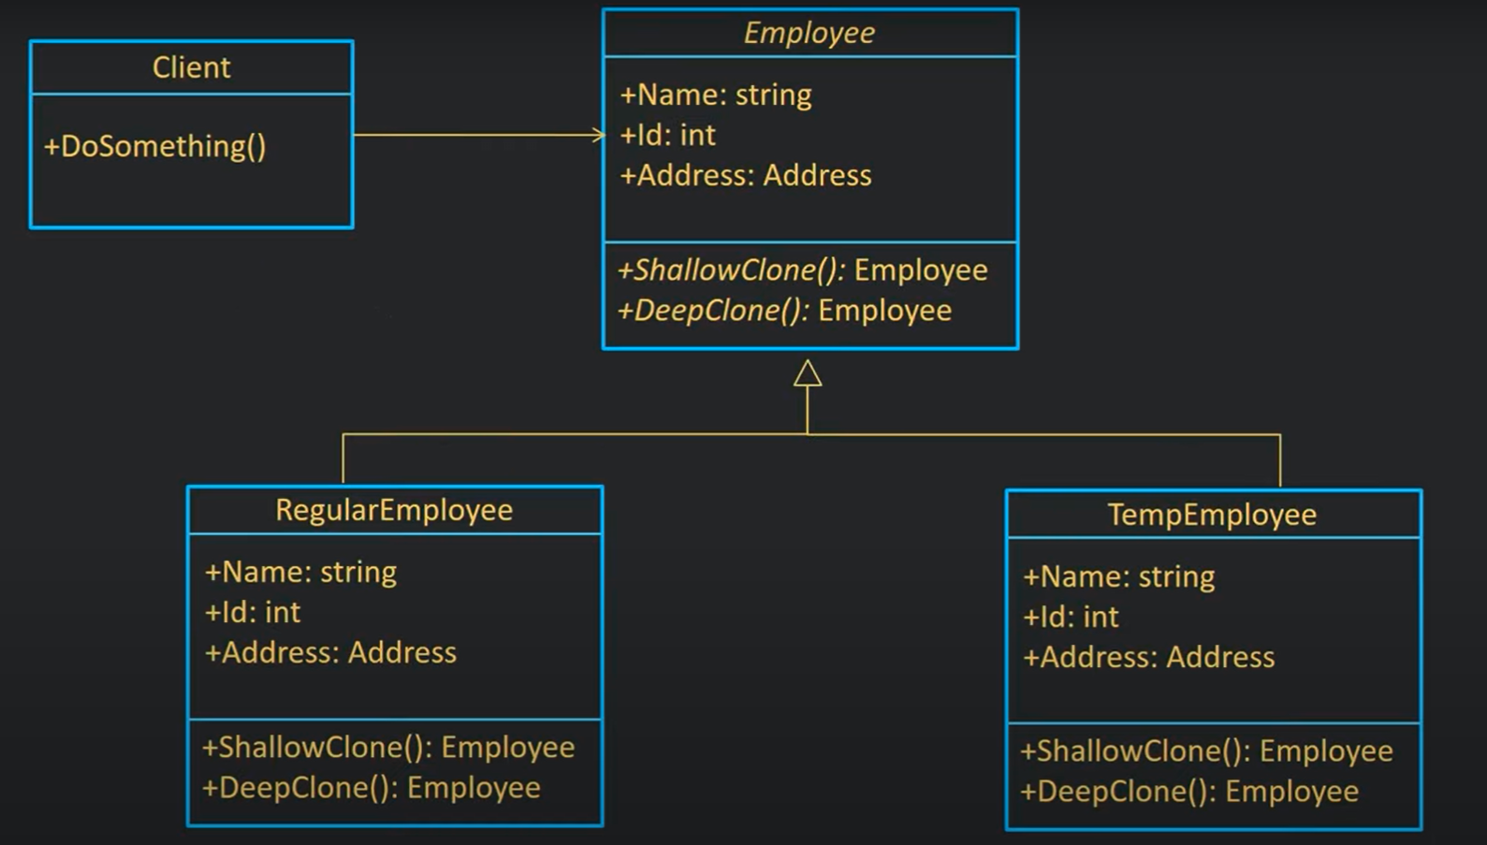
Prototype Design Pattern UML

Slide 6
Shallow And Deep Copy
Shallow and Deep Copy : The idea of using copy is to create a new object of the same type without knowing the exact type of the object we are invoking

Slide 7
Shallow Copy
Copies an object's value type fields into the target object and the object's reference types are copied as references into the target object.
Main Object
Memory
Shallow Object
<< Employee >>
ID
Name
Address
Emp:Employee
Emp:EmployeeShallow
Addr:Address
<< Employee >>
ID
Name
Address

Slide 8
Deep Copy
Copies an object's value and reference types into a complete new copy of the target objects.
Main Object
Memory
Deep Object
<< Employee >>
ID
Name
Address
Emp:Employee
Addr1:Address
Emp:EmployeeShallow
Addr2:Address
<< Employee >>
ID
Name
Address

Slide 9
MemberwiseClone Method
The MemberwiseClone method is part of system.object and creates a shallow copy of the given object.
In the process of copying, if a field is a value type, a bit by bit copy of the field is performed.
If a field is reference type, the reference is copied but the referenced object is not

Slide 10
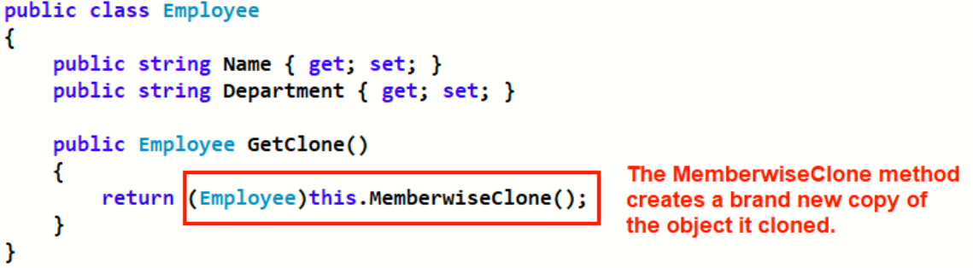
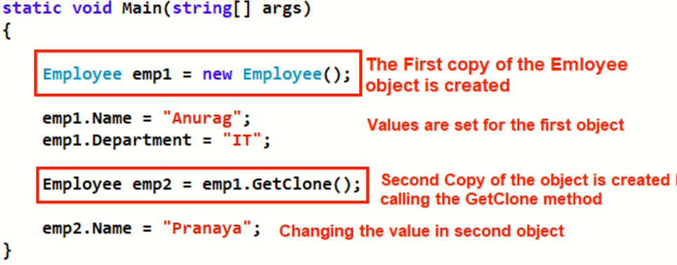
MemberwiseClone Method

Slide 11
ICloneable Interface
The ICloneable interface provides with a customized implementation that creates copy of an existing object.
The ICloneable interface contains one member, the clone method, which is intended to provide support beyond MemberwiseClone method

Slide 12
References
Prototype design pattern
https://www.bing.com/videos/search?q=prototype+design+pattern+ppt&docid=608011879039315420&mid=A7A9B7C49646E86E008CA7A9B7C49646E86E008C&view=detail&FORM=VIRE
https://www.bing.com/videos/search?&q=prototype+design+pattern+ppt&docid=608011879039315420&mid=AEE63C429513C82EF9A7AEE63C429513C82EF9A7&view=detail&FORM=VDRVRV&rvsmid=A7A9B7C49646E86E008CA7A9B7C49646E86E008C&ajaxhist=0
https://www.youtube.com/watch?v=EiqLJ_3ynTw&list=PLnqAlQ9hFYdewk9UKGBcHLulZNUBpNSKJ&index=9
Serialization
https://www.youtube.com/watch?v=N_e_L5SM4nY

Slide 13
Thank You ❤

